Slide 1
Java Generics

Slide 2
Lecture Objectives
To understand the objective of generic programming
To be able to implement generic classes and methods
To know the limitations of generic programming in Java
To understand the relationship between generic types and inheritance

Slide 3
Parameterized Classes and Generics
The class ArrayList is a parameterized class
It has a parameter, denoted by Base_Type, that can be replaced by any reference type to obtain a class for ArrayLists with the specified base type
Starting with version 5.0, Java allows class definitions with parameters for types
  These classes that have type parameters are called parameterized class or generic definitions, or, simply, generics

Slide 4
Generics (Cont’d)
A class definition with a type parameter is stored in a file and compiled just like any other class.
Once a parameterized class is compiled, it can be used like any other class.
  However, the class type plugged in for the type parameter must be specified before it can be used in a program.
  Doing this is said to instantiate the generic class.
    Sample<String> object = new Sample<String>();

Slide 5
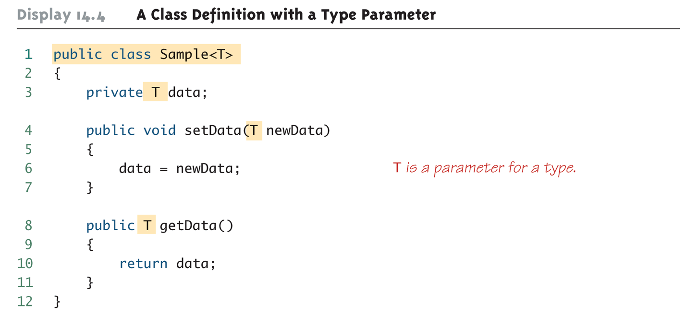
A Class Definition with a Type Parameter

Slide 6
A Class Definition with a Type Parameter (Cont’d)
A class that is defined with a parameter for a type is called a generic class or a parameterized class
  The type parameter is included in angular brackets after the class name in the class definition heading.
  Any non-keyword identifier can be used for the type parameter, but by convention, the parameter starts with an uppercase letter.
  The type parameter can be used like other types used in the definition of a class.

Slide 7
Tip: Compile with the -Xlint Option
There are many pitfalls that can be encountered when using type parameters
Compiling with the -Xlint option will provide more informative diagnostics of any problems or potential problems in the code
  javac –Xlint Sample.java
  Question: How would you do that in JCreator?

Slide 8
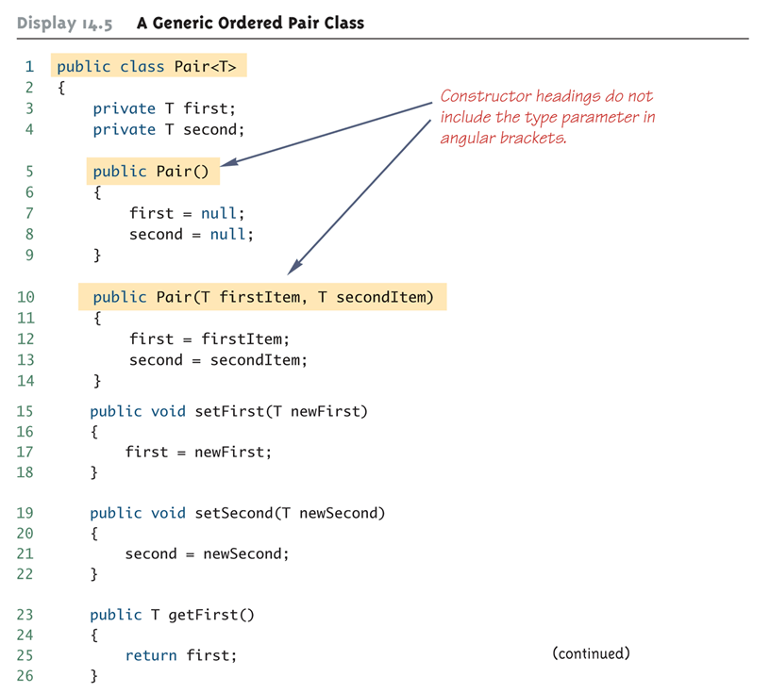
Generic Class Definition: An Example

Slide 9
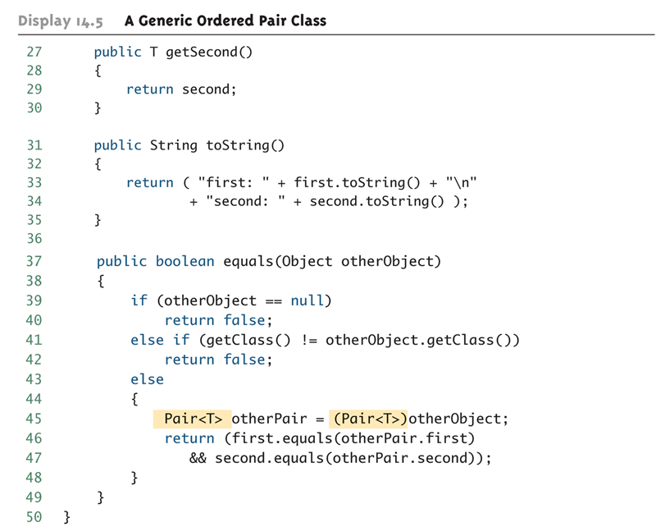
Generic Class Definition: An Example (Cont’d)

Slide 10
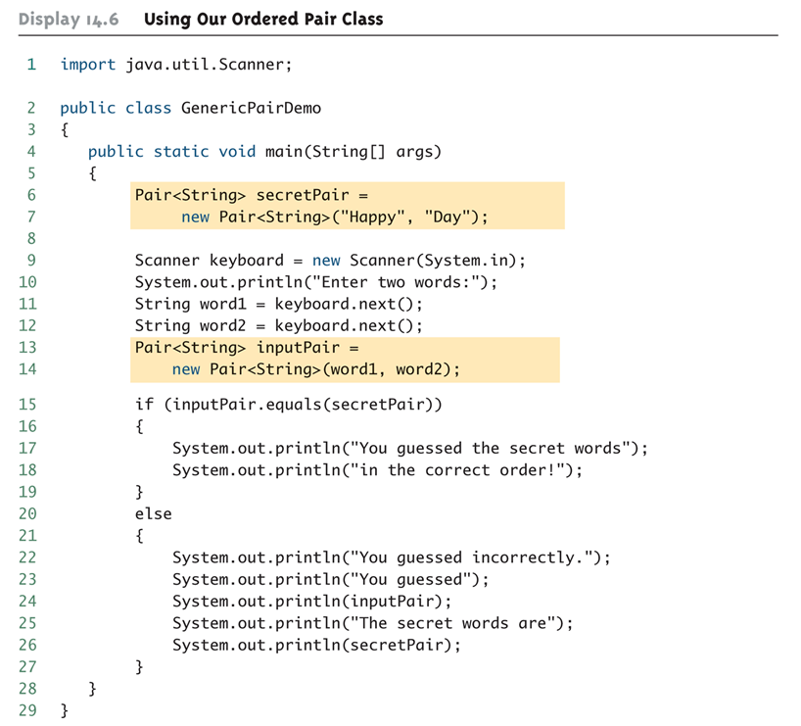
Generic Class Usage: An Example

Slide 11
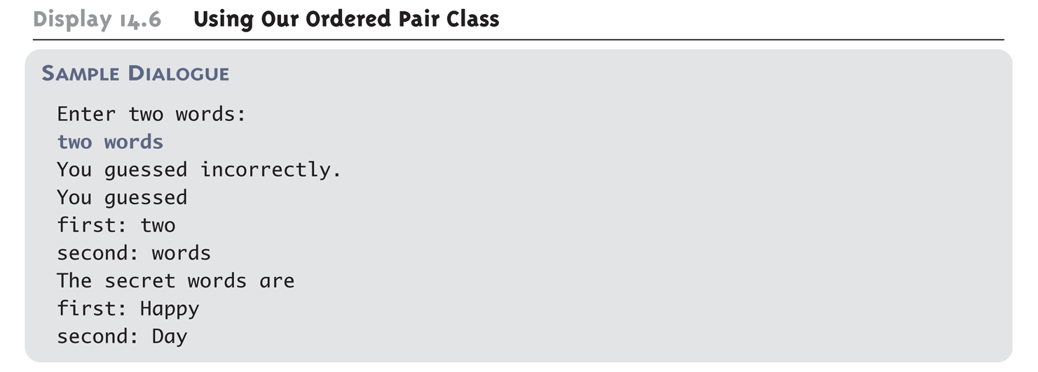
Generic Class Usage: An Example (Cont’d)
Program Output:

Slide 12
A Generic Constructor Name Has No Type Parameter!!!
Although the class name in a parameterized class definition has a type parameter attached, the type parameter is not used in the heading of the constructor definition:
    public Pair<T>()
A constructor can use the type parameter as the type for a parameter of the constructor, but in this case, the angular brackets are not used:
    public Pair(T first, T second)
However, when a generic class is instantiated, the angular brackets are used:
    Pair<String> pair = new Pair<STring>("Happy", "Day");

Slide 13
A Primitive Type Cannot be Plugged in for a Type Parameter!!!
The type plugged in for a type parameter must always be a reference type:
  It cannot be a primitive type such as int, double, or char
  However, now that Java has automatic boxing, this is not a big restriction.
  Note: Reference types can include arrays.

Slide 14
Limitations on Type Parameter Usage
Within the definition of a parameterized class definition, there are places where an ordinary class name would be allowed, but a type parameter is not allowed.
In particular, the type parameter cannot be used in simple expressions using new to create a new object
  For instance, the type parameter cannot be used as a constructor name or like a constructor:
    T object = new T();
    T[] a = new T[10];

Slide 15
Limitations on Generic Class Instantiation
Arrays such as the following are illegal:
  Pair<String>[] a =
  new Pair<String>[10];
Although this is a reasonable thing to want to do, it is not allowed given the way that Java implements generic classes

Slide 16
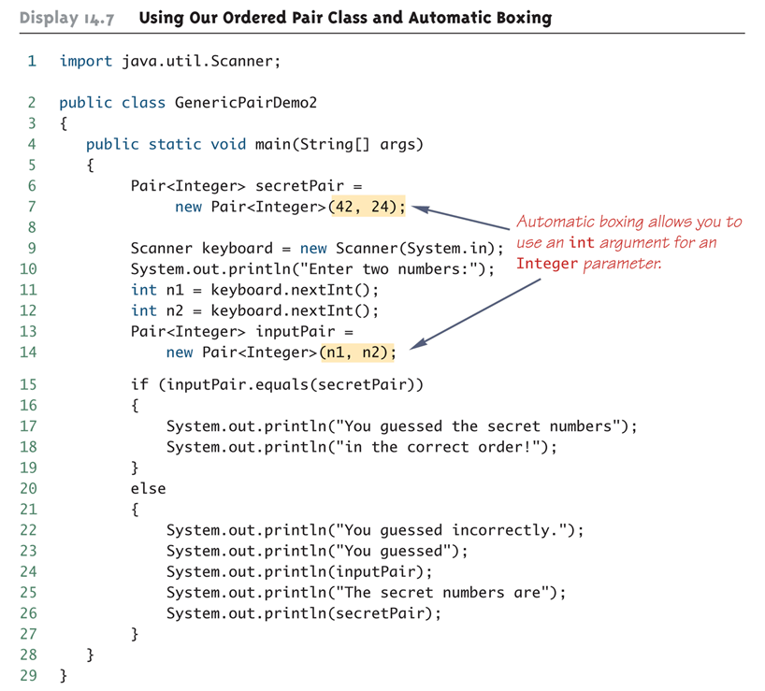
Using Generic Classes and Automatic Boxing

Slide 17
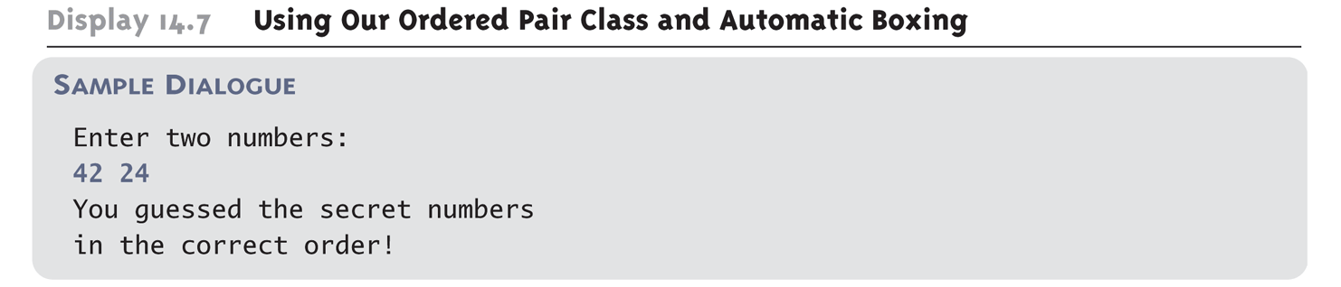
Using Generic Classes and Automatic Boxing (Cont’d)
Program Output:

Slide 18
Multiple Type Parameters
A generic class definition can have any number of type parameters.
  Multiple type parameters are listed in angular brackets just as in the single type parameter case, but are separated by commas.

Slide 19
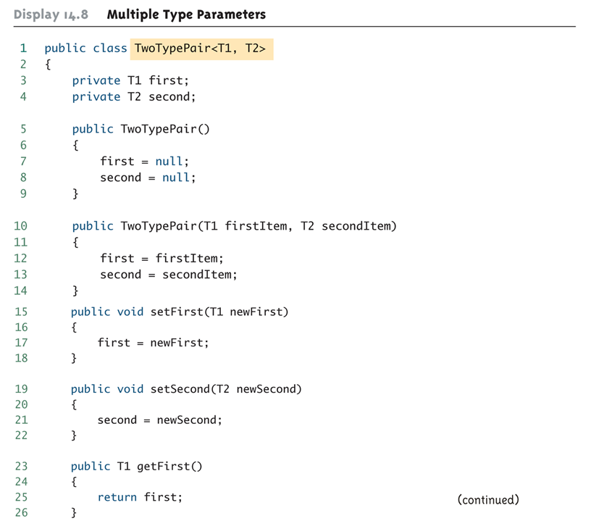
Multiple Type Parameters (Cont’d)

Slide 20
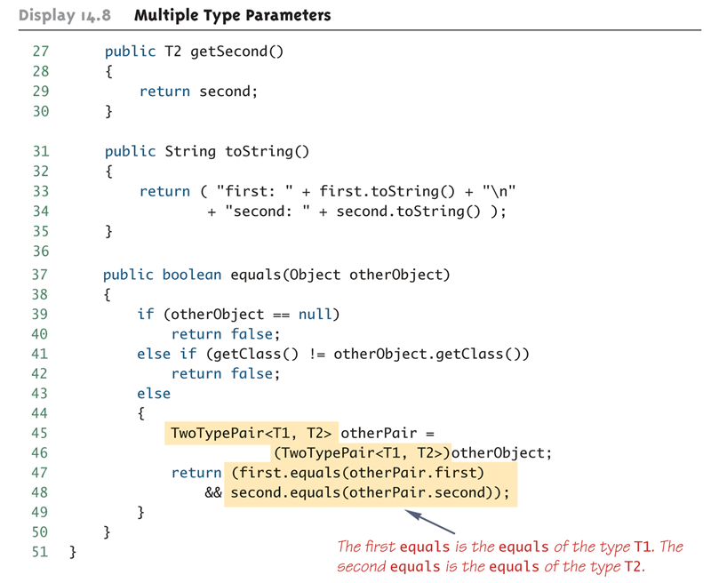
Multiple Type Parameters (Cont’d)

Slide 21
A Generic Classes and Exceptions
It is not permitted to create a generic class with Exception, Error, Throwable, or any descendent class of Throwable
  A generic class cannot be created whose objects are throwable
    public class GEx<T> extends Exception
  The above example will generate a compiler error message

Slide 22
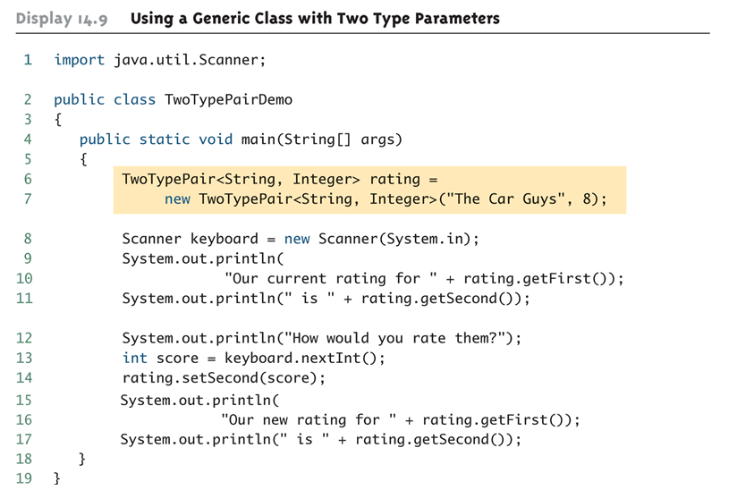
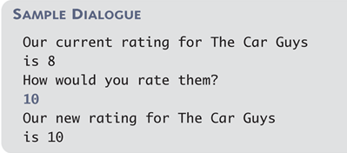
Using a Generic Class with Two Type Parameters
Program Output:

Slide 23
Bounds for Type Parameters
Sometimes it makes sense to restrict the possible types that can be plugged in for a type parameter T.
  For instance, to ensure that only classes that implement the Comparable interface are plugged in for T, define a class as follows:
    public class RClass<T extends Comparable>
  "extends Comparable" serves as a bound on the type parameter T.
  Any attempt to plug in a type for T which does not implement the Comparable interface will result in a compiler error message.

Slide 24
Bounds for Type Parameters (Cont’d)
A bound on a type may be a class name (rather than an interface name)
  Then only descendent classes of the bounding class may be plugged in for the type parameters:
  public class ExClass<T extends Class1>
A bounds expression may contain multiple interfaces and up to one class.
If there is more than one type parameter, the syntax is as follows:
  public class Two<T1 extends Class1, T2 extends Class2 & Comparable>

Slide 25
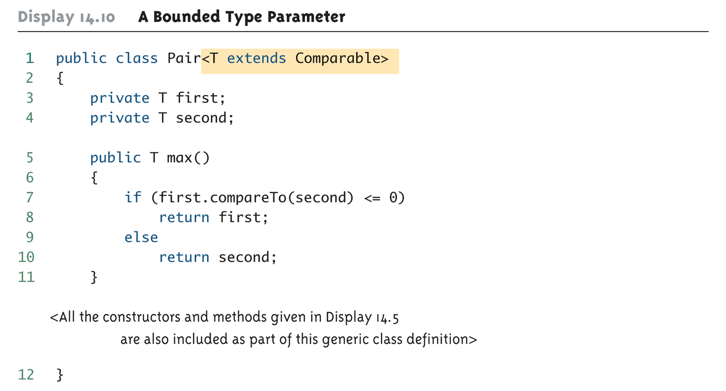
Bounds for Type Parameters (Cont’d)

Slide 26
Generic Interfaces
An interface can have one or more type parameters.
The details and notation are the same as they are for classes with type parameters.

Slide 27
Generic Methods
When a generic class is defined, the type parameter can be used in the definitions of the methods for that generic class.
In addition, a generic method can be defined that has its own type parameter that is not the type parameter of any class
  A generic method can be a member of an ordinary class or a member of a generic class that has some other type parameter.
  The type parameter of a generic method is local to that method, not to the class.

Slide 28
Generic Methods (Cont’d)
The type parameter must be placed (in angular brackets) after all the modifiers, and before the returned type:
  public static <T> T genMethod(T[] a)
When one of these generic methods is invoked, the method name is prefaced with the type to be plugged in, enclosed in angular brackets
  String s = NonG.<String>genMethod(c);

Slide 29
Inheritance with Generic Classes
A generic class can be defined as a derived class of an ordinary class or of another generic class
  As in ordinary classes, an object of the subclass type would also be of the superclass type
Given two classes: A and B, and given G: a generic class, there is no relationship between G<A> and G<B>
  This is true regardless of the relationship between class A and B, e.g., if class B is a subclass of class A

Slide 30
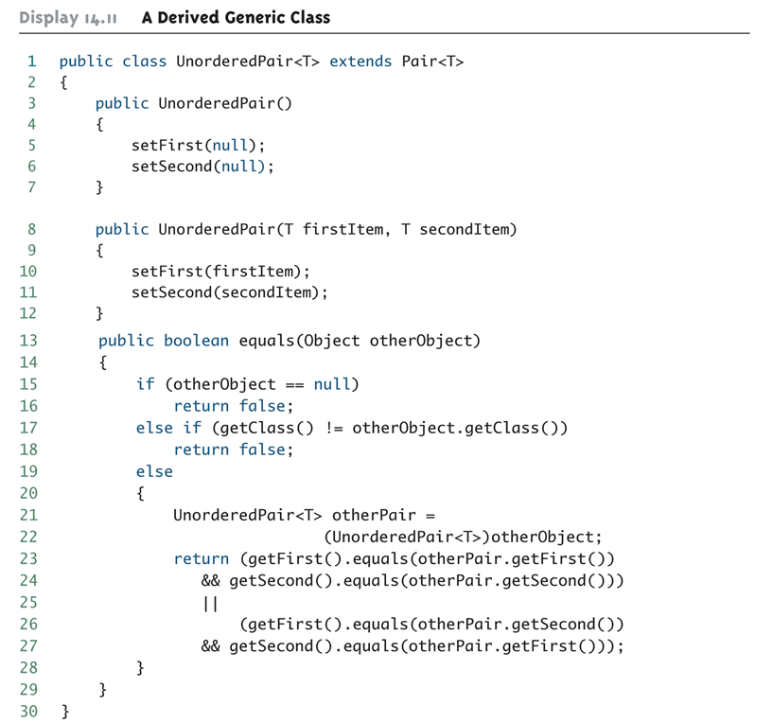
A Derived Generic Class: An Example

Slide 31
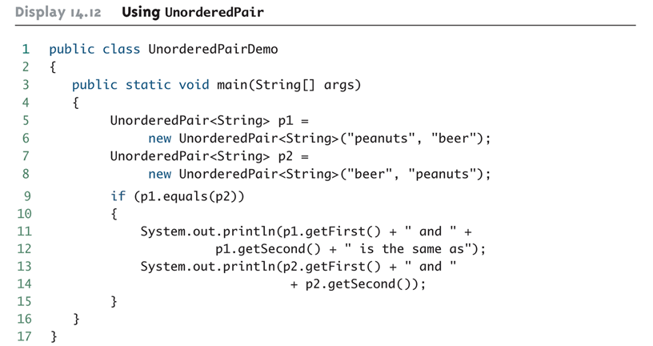

A Derived Generic Class: An Example (Cont’d)
Program Output:

